Slide 1
Rajiv Gandhi University of Knowledge Technologies-Basar
MAJOR PROJECT
ALPHA TO OMEGA PROJECTS
Project Guide Team Members
K. GEETHA L. Anjali
Assistant professor S.vidya
G.Madhuri

Slide 2
Introduction
Selecting an idea for implementation which is no where before is a key stone for all students. Providing the details of implemented ideas to avoid redundancy and insights for future development to grease the process where they left is an efficient thought.
our idea proposes a online platform for professors and students where they can access the project details and project guide information at an ease.

Slide 3
Objective:
Alpha to omega projects will provide a web application which includes the professors profile with the projects done.
It also provide e – platform for students who want to do projects under their favourite guide.
The project status and related information will avoid redundancy.Ease in updation, completion and redevelopment of unturned ideas in future.

Slide 4
GANTT CHART SCHEDULE
SCHEDULE | Date | Date
1 | 01-10-2023 | 15-10-2023
2 | 01-11-2023 | 10-11-2023
3 | 12-11-2023 | 20-11-2023
4 | 21-11-2023 | 30-11-2023

Slide 5
ER MODEL

Slide 6
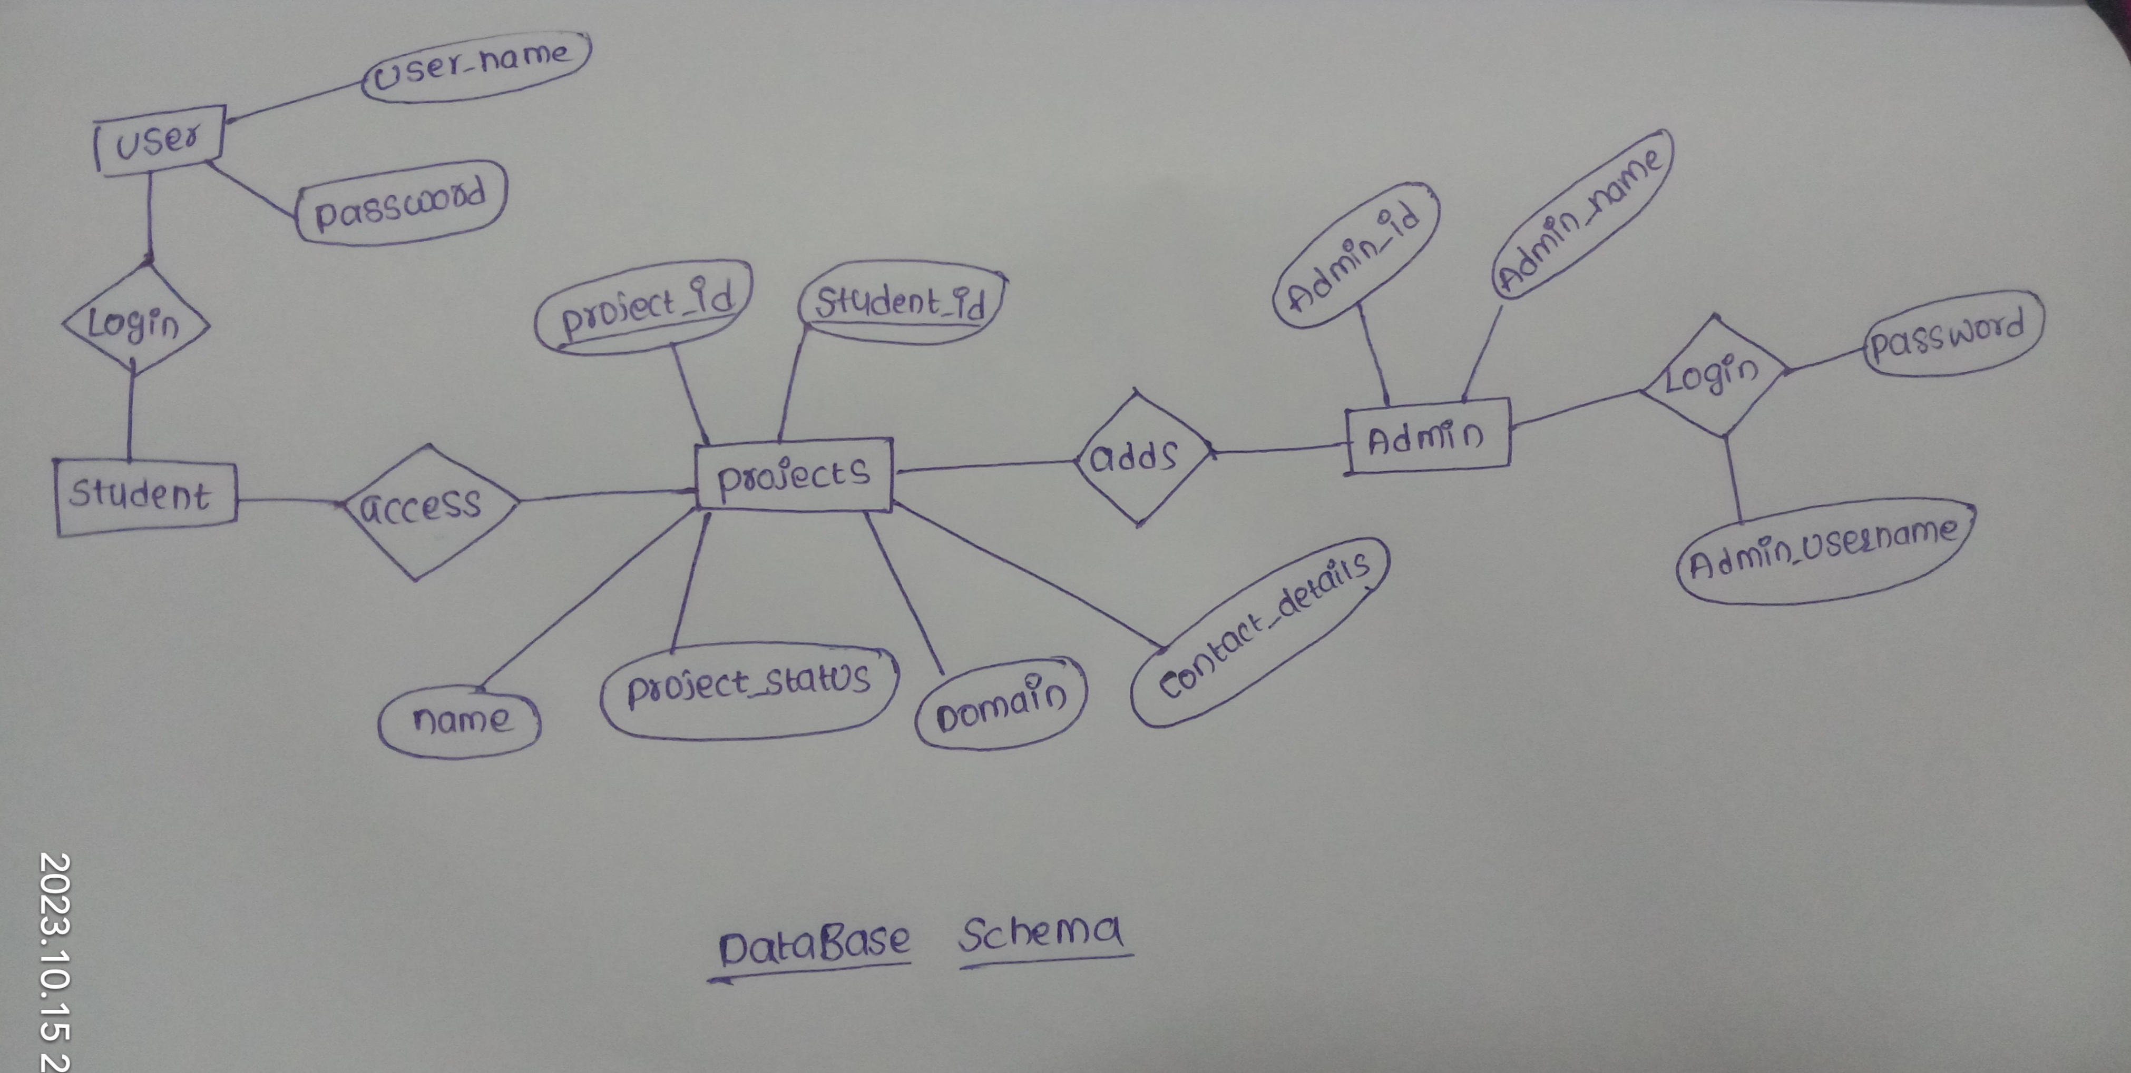
Database design

Slide 7
Implementation
Planning :
Defining the objective of the task. Modelling the features required accordingly.
Tech Bucket and Tools Gathering
Gathering the technical information and tools .Language inclusions HTML, CSS , JavaScript with Storage facility.
Database Designing:
Data and entities structures designing. User student and Admin privilege features are included.

Slide 8
Tech stack:
Front end :
HTML
CSS
JAVASCRIPT
Backend:
Data Base
SQL

Slide 9
Modules
Admin :
Admin will have the read and write privileges. Project guide will be having the privileges of Admin. Admin will have all the project data which are implemented under his supervision.
User:
Use can view the guide and project details. Student is the user with limited privileges. User will also have the project registration facilitity etc.

Slide 10
References

Slide 11
Thank you

